Slide 1
Unit 4: ENTREPRENEURSHIP EVOLUTION OF CONCEPT OF ENTREPRENEUR
The word ‘entrepreneur’ is derived from French word ‘Entreprendre’ which was used to designate an organizer of musical or other entertainments. Later in 16th century it was used for army leaders. It was extended to cover civil engineering activities such as construction in 17th century.
CONCEPT OF ENTREPRENEUR
As said above entrepreneur is used in various ways and various views. These views are broadly classified into three groups, namely risk bearer, organizer and innovator.
Entrepreneur as risk bearer: P.H. Knight described entrepreneur to be a specialized group of persons who bear uncertainty. Uncertainty is defined as risk, which cannot be insured against and is incalculable.
Entrepreneur as an organizer: According to J Baptist Say “an entrepreneur is one who combines the land of one, the labor of another and capital of yet another, and thus produces a product.

Slide 2
Entrepreneur as an innovator: Joseph A SchumPeter in 1934 assigned a crucial role of ‘innovation’ to the entrepreneur. He considered economic development as a dynamic change brought by entrepreneur by instituting new combinations of factors of production, i.e. innovations.
Definition of entrepreneur:
an entrepreneur can be defined as a person who tries to create something new, organizes production and undertakes risks and handles economic uncertainty involved in enterprise.
Peter F. Drucker defines an entrepreneur as one who always searches for change, responds to it and exploits it as an opportunity. Innovation is the basic tool of entrepreneurs, the means by which they exploit change as an opportunity for a different business or service.

Slide 3
CHARACTERISTICS OF ENTREPRENEUR
Personal entrepreneurial characteristics:
 | Core competencies | Entrepreneurial activities
1 | Initiative | Does things before asked for or forced to by events and acts to extend the business to new areas, products or services.
2 | Perceiving opportunities | Identifies business opportunities and mobilizes necessary resources to make good an opportunity.
3 | Persistence | Takes repeated or different actions to overcome obstacles.
4 | Information gathering | Consults experts for business and technical advice. Seeks information of client or supplier’s needs. Personally undertakes market research and make use of personal contacts or information networks to obtain useful information.
5 | Concern for quality work | States desire to produce or sell a better quality product or service. Compares his performance favorably with that of others.

Slide 4
 | Core competencies | Entrepreneurial activities
6 | Commitment to contractual obligations | Makes a personal sacrifice or expands extraordinary effort to complete a job, accepts full responsibility in completing a job contract on schedule, pitches in with workers or work in their place to get the job done and shows utmost concern to satisfy the customer.
7 | Efficiency orientation | Finds ways and means to do things faster, better and economically.
8 | Planning | Various inter-related jobs are synchronized according to plan.
9 | Problem solving | Conceives new ideas and finds innovative solutions.
10 | Self-confidence | Makes decisions on his own and sticks to it in spite of initial setbacks.
11 | Experience | Possesses technical expertise in areas of business, finance, marketing, etc.
12 | Self-critical | Aware of personal limitations but tries to improve upon by learning from his past mistakes or experiences of others and is never complacent with success.

Slide 5
 | Core competencies | Entrepreneurial activities
13 | Persuasion | Persuades customers and financiers to patronize his business.
14 | Use of influence strategies. | Develops business contacts, retains influential people as agents and restricts dissemination of information in his possession.
15 | Assertiveness | Instructs, reprimands or disciplines for failing to perform.
16 | Monitoring | Develops a reporting system to ensure that work is completed and quality norms.
17 | Credibility | Demonstrates honesty in dealing with employees, suppliers and customers even if it means a loss of business.
18 | Concern for employee welfare | Expresses concern for employees by responding promptly to their grievances.
19 | Impersonal relationship | Places long-term goodwill over short-term gain in a business relationship.
20 | Expansion of capital base | Reinvests a greater portion of profits to expand capital of the firm.
21 | Building product image | Concerned about the image of his products among consumers and does everything possible to establish a niche for his products in the market.

Slide 6
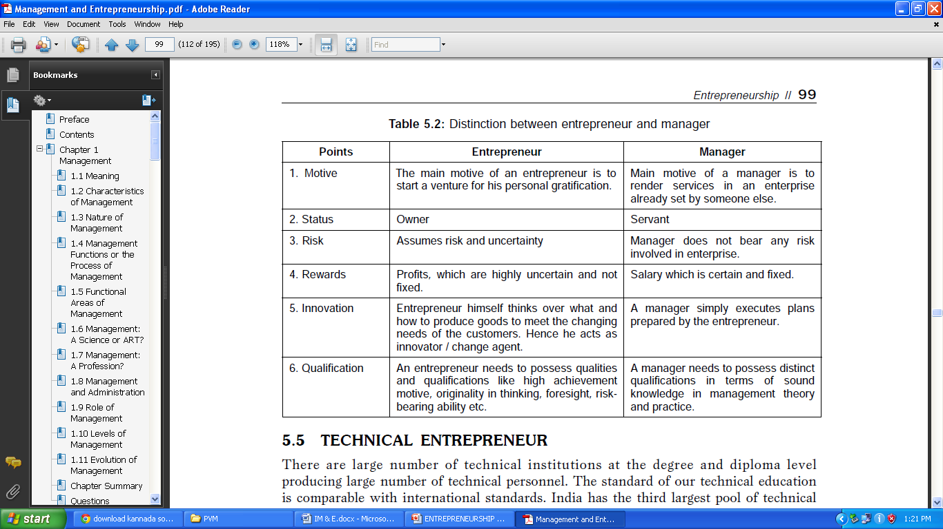
DISTINCTION BETWEEN ENTREPRENEUR AND MANAGER

Slide 7
TECHNICAL ENTREPRENEUR:
There are large number of technical institutions at the degree and diploma level producing large number of technical personnel. The standard of our technical education is comparable with international standards.
Rewards for an Entrepreneur
1. Freedom to work.
2. Satisfaction of being own boss.
3. Power to do things as he likes.
4. Rewards of ownership and retirement assurance.
5. Respect of family and friends.
Penalties for an Entrepreneur
1. Constraints of financiers, laborers, customers, suppliers, and debtors curtail his freedom.
2. Frustration due to availability of limited capital and other resources.
3. Social and family life is affected due to hard long hours of working.
4. Frustration due to non-achievement of full objectives.
5. Risk of failure.

Slide 8
FUNCTIONS OF AN ENTREPRENEUR
1. Idea generation: The first and the most important function of an Entrepreneur is idea generation. Idea generation implies product selection and project identification.
2. Determination of business objectives: Entrepreneur has to state and lay down the business objectives. Objectives should be spelt out in clear terms
3. Rising of funds All the activities of the business depend upon the financeand hence fund rising is an important function of an Entrepreneur.
4. Procurement of machines and materials: Another important function of an Entrepreneur is to procure raw materials and machines.
Cont…..

Slide 9
5. Market research: Market research is the systematic collection of data regarding the product which the Entrepreneur wants to manufacture.
6. Determining form of enterprise: Entrepreneur has to determine form of enterprise depending upon the nature of the product, volume of investment etc.
7. Recruitment of manpower: To carry out this function an Entrepreneur has to perform the following activities.
(a) Estimating man power requirement for short term and long term.
(b) Laying down the selection procedure.
(c) Designing scheme of compensation.
(d) Laying down the service rules.
(e) Designing mechanism for training and development.
8. Implementation of the project: Entrepreneur has to develop schedule and action plan for the implementation of the project.

Slide 10
TYPES OF ENTREPRENEUR
Clearance Danhof’s Classifications
Danhof classifies Entrepreneur into four types
1. Innovative entrepreneur: This category of Entrepreneur is characterized by smell of innovativeness.
2. Adoptive or imitative entrepreneur: Such entrepreneurs imitate the existing
entrepreneur and set their enterprise in the same manner.
3. Fabian entrepreneurs: Fabian entrepreneurs are characterized by great
caution and skepticism, in experimenting any change in their enterprises.
4. Drone entrepreneurs: Such entrepreneurs are conservative or orthodox in outlook

Slide 11
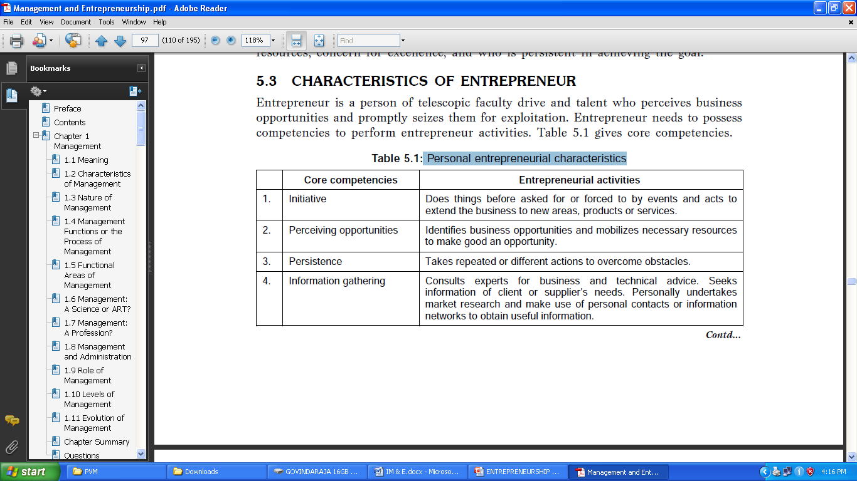
INTRAPRENEURS new breed of entrepreneurs is coming to the fore in large industrial organizations. They are called as ‘Intrapreneurs’. In large organizations, the top executives are encouraged to catch hold of new ideas and then convert them into products through R and D activities within the framework of organizations.

Slide 12
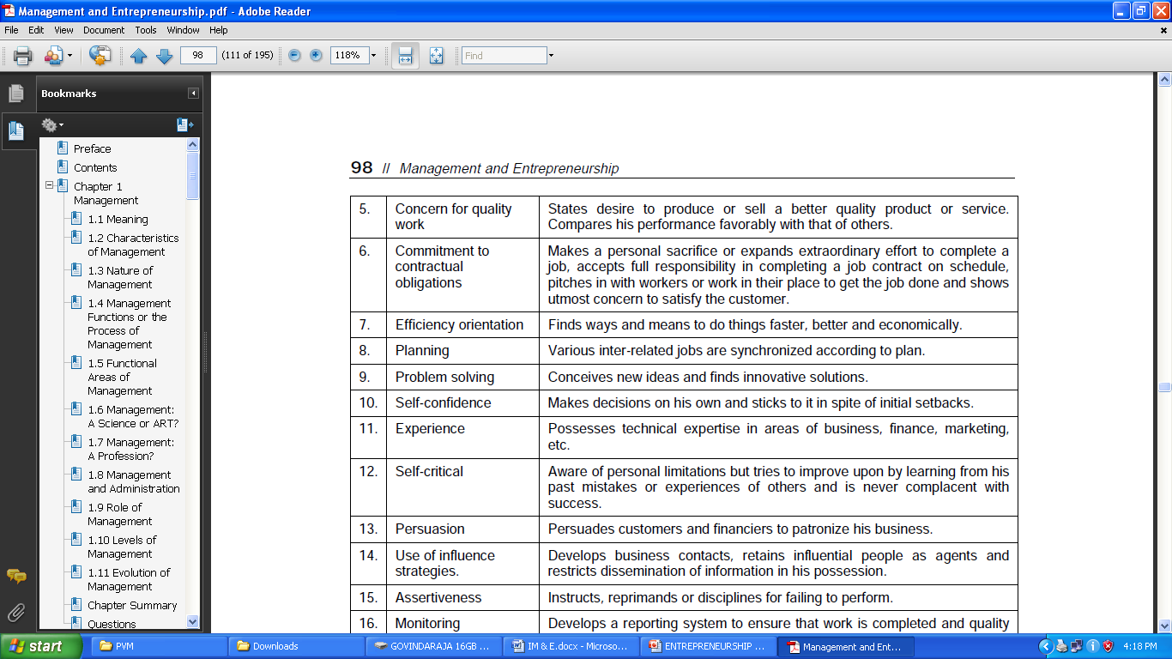

Slide 13
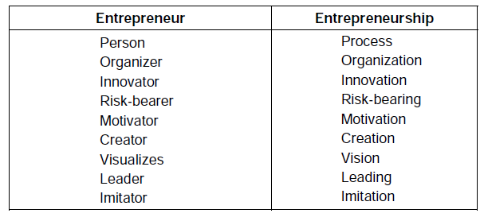
CONCEPT OF ENTREPRENEURSHIP
“Entrepreneurship is the attempt to create value through recognition of business opportunity, the management of risk taking appropriate to the opportunity and through the communicative and management skills to mobilize human, financial and material resources necessary to bring a project to fruition”.
Relationships between entrepreneur and entrepreneurship

Slide 14
EVOLUTION OF ENTREPRENEURSHIP
Emergence of entrepreneurial class is as old as our ancient history itself. It dates back to the Pre-Vedic period when Harappan culture flourished in India.
Entrepreneurship during pre-independence: In the excavation in Harappan and Mohanjodaro the handcraft items and metal molded items were found. Unfortunately the prestigious Indian handicrafts industries which were basically a cottage and tiny sector declined at the end of 18th century, because of the following reasons.
1. Disappearance of royal patronage to the handicrafts
2. Lukewarm attitude of British colonial towards Indian crafts
3. Imposition of heavy duty on imports of Indian crafts
4. Low priced British made goods
5. Changes in the tastes and habits of developing Indian citizens etc.

Slide 15
Entrepreneurship during post-independence: In 1948 Indian government came forward with the first Industrial policy, which was revised from time to time
The government took three important measures namely:
1. To maintain a proper distribution of economic power between private and public sector.
2. To encourage industrialization from existing centers to other cities, towns and villages.
3. To disseminate the entrepreneurship acumen concentrated in a few dominant communities to a large number of industrially potential people of varied social state.

Slide 16
ROLE OF ENTREPRENEURSHIP IN ECONOMIC DEVELOPMENT
Economic development essentially means a process of upward change whereby the real per capita income of a country increases for a long period of time. The economic history of the presently developed countries, for example, USA and Japan tends to support the facts that the economy is an effect for which the entrepreneurship is the cause.
1. Entrepreneurship promotes capital formation by mobilizing the idle saving of the public.
2. It provides immediate large-scale employment. Thus it helps to reduce unemployment in the country.
Cont…..

Slide 17
3. It provides balanced regional development.
4. It helps reduce the concentration of economic power.
5. It stimulates the equitable redistribution of wealth, income and even political power in the interest of the country.
6. It encourages effective resources mobilization of capital and skill which might otherwise remain unutilized and idle.
7. It also induces backward and forward linkages which stimulated the process of economic development in the country.
8. It promotes country’s export trade i.e. an important ingredient for economic development.

Slide 18
STAGES IN THE ENTREPRENEURIAL PROCESS
Entrepreneurship is a process of comprising several distinct stages. The first stage in the entrepreneurial process is some change in the real world. For example, a war may destroy country’s manufacturing facilities but spare its trained work force that has happened in West Germany during Second World War. Such a change leads to changes in every aspect of life in the country. It creates needs for new goods and services.

Slide 19
BARRIERS TO ENTREPRENEURSHIP
1. Lack of a viable concept
2. Lack of market knowledge
3. Lack of technical skills
4. Lack of seed capital
5. Lack of business know how
6. Complacency—lack of motivation
7. Social stigma
8. Time presence and distractions
9. Legal constraints and regulations
10. Monopoly and protectionism
11. Inhibitions due to patents

